Slide 1

Unsupervised Learning: K Means Clustering and PCA
Abdullah Saihan
Artificial Intelligence Engineer

Slide 2
K-Means Clustering

Slide 3
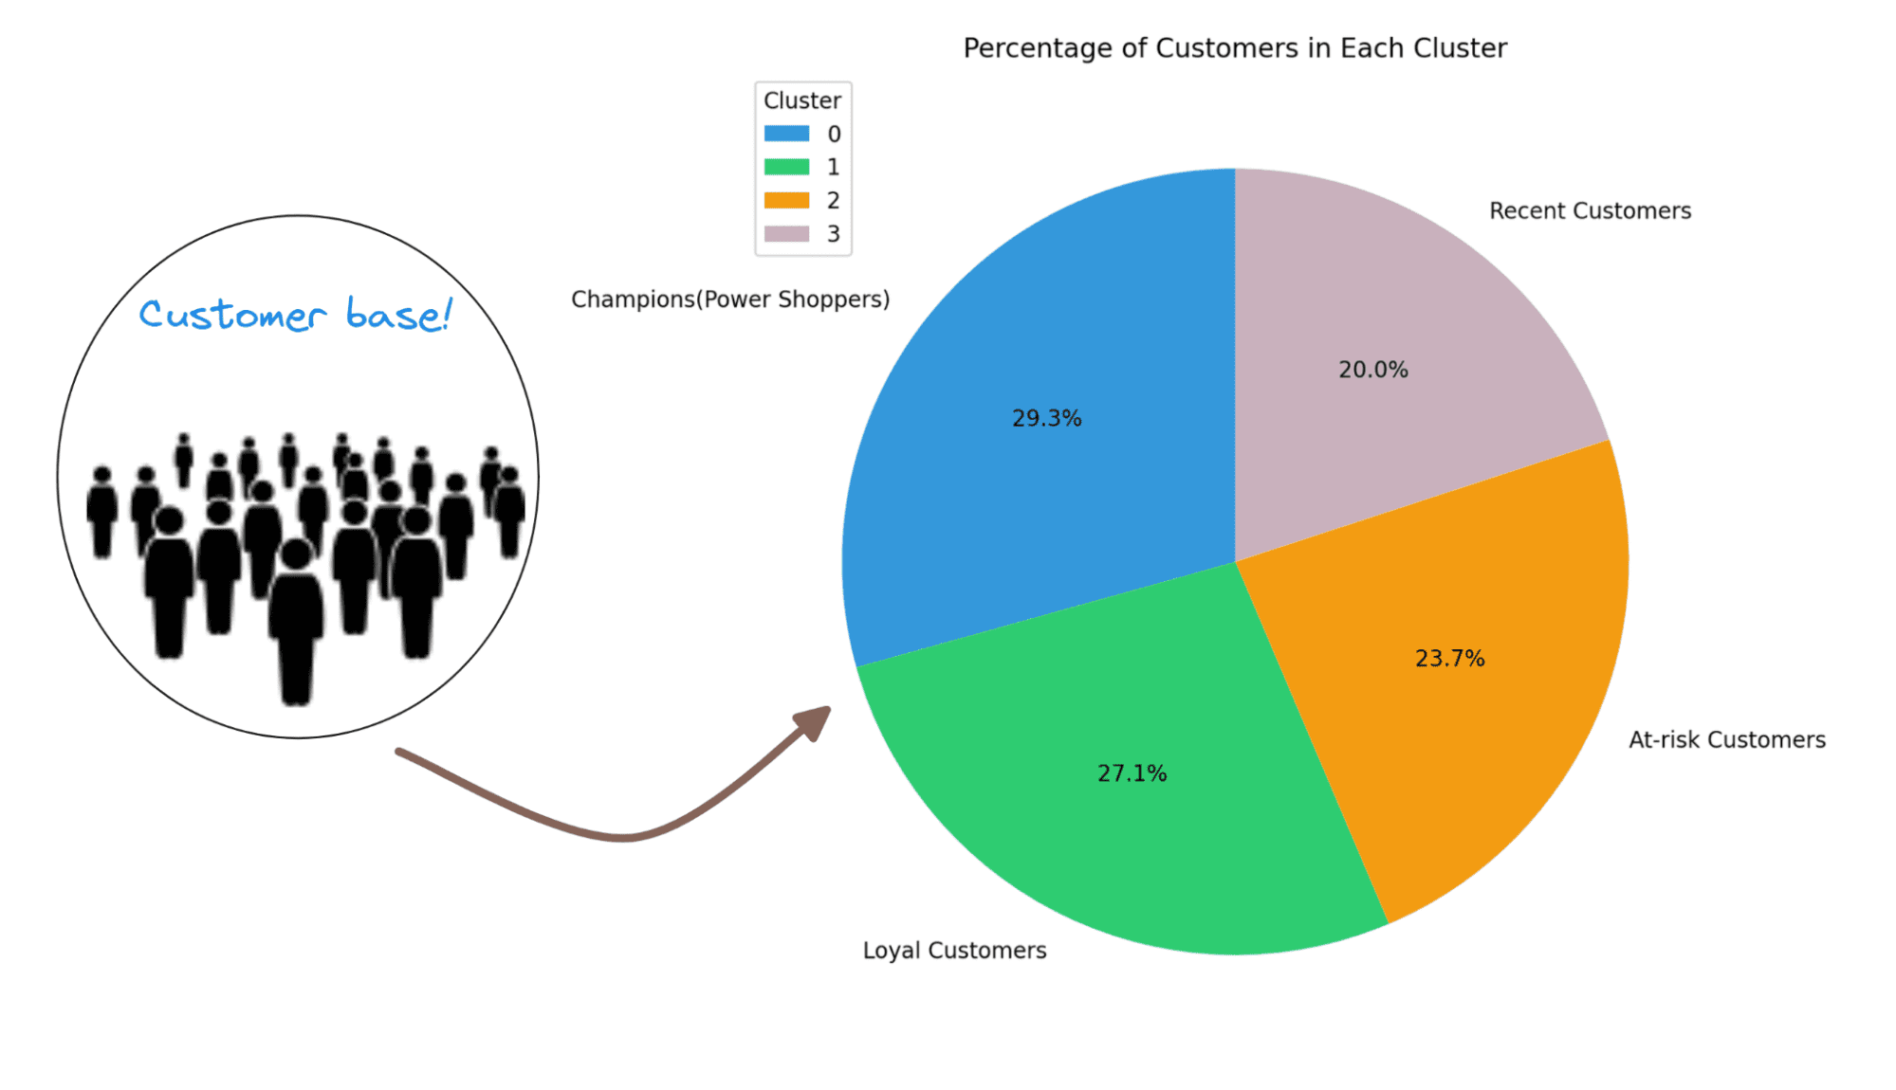
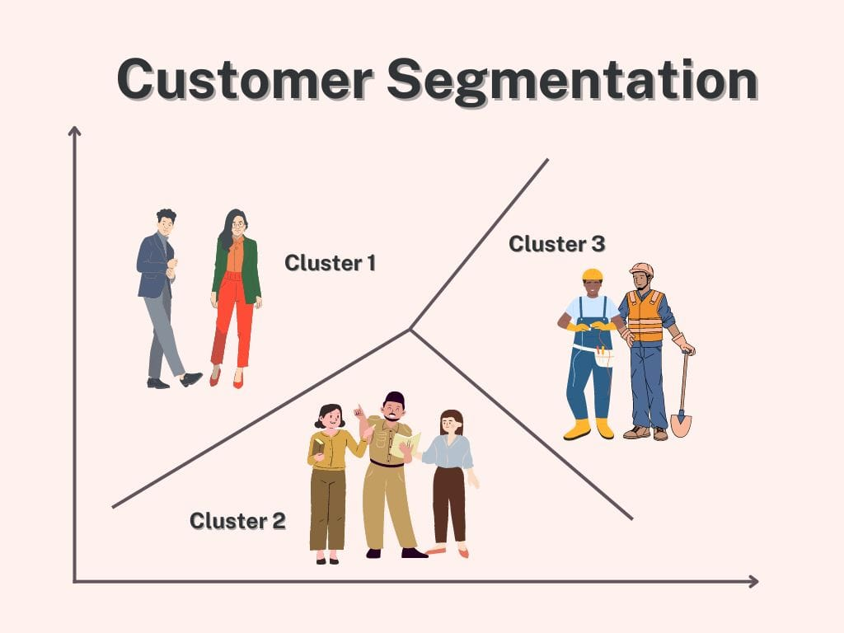
Customer Segmentation

Slide 4
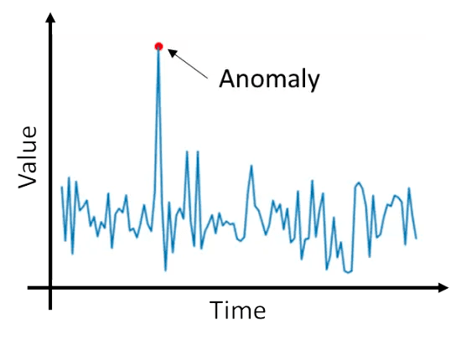
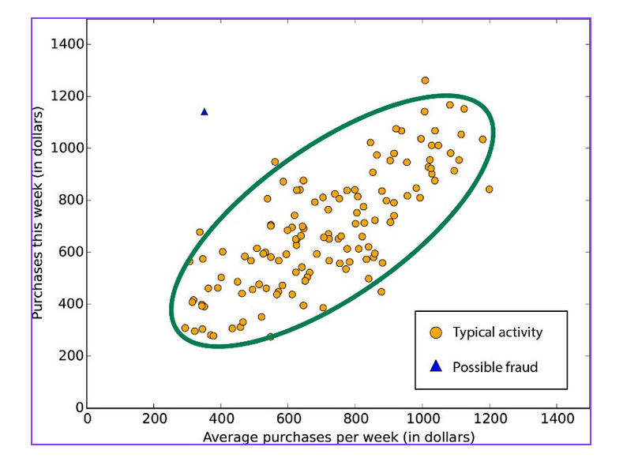
Anomaly Detection

Slide 5
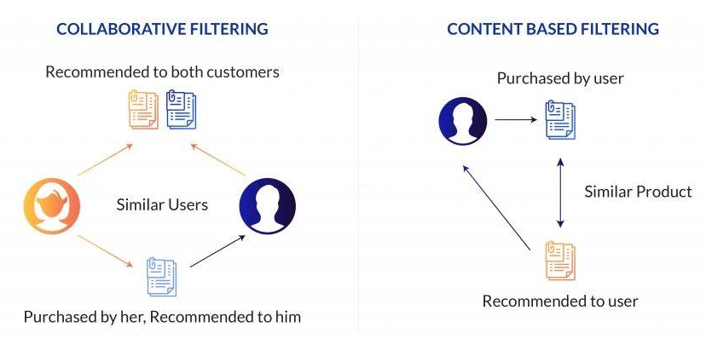
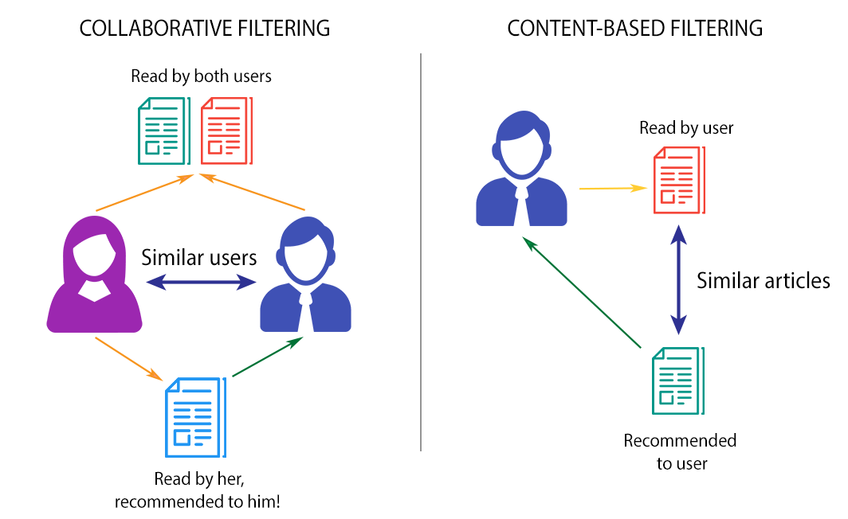
Recommendation Engine

Slide 6
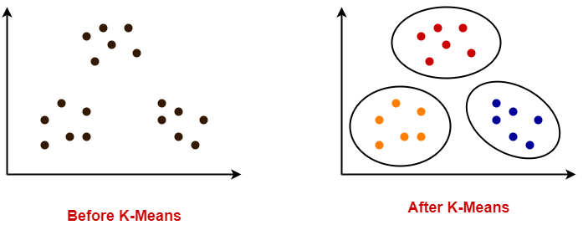
K Means Clustering

Slide 7
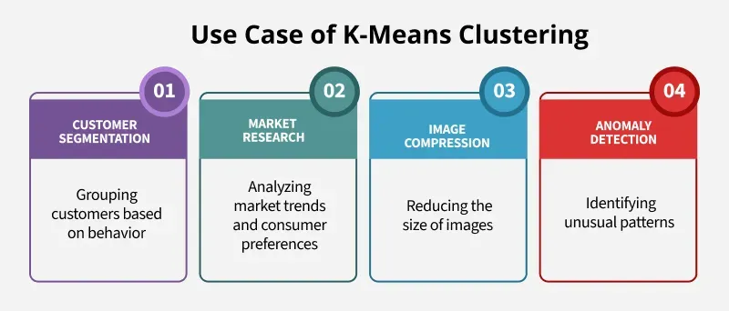

Slide 8
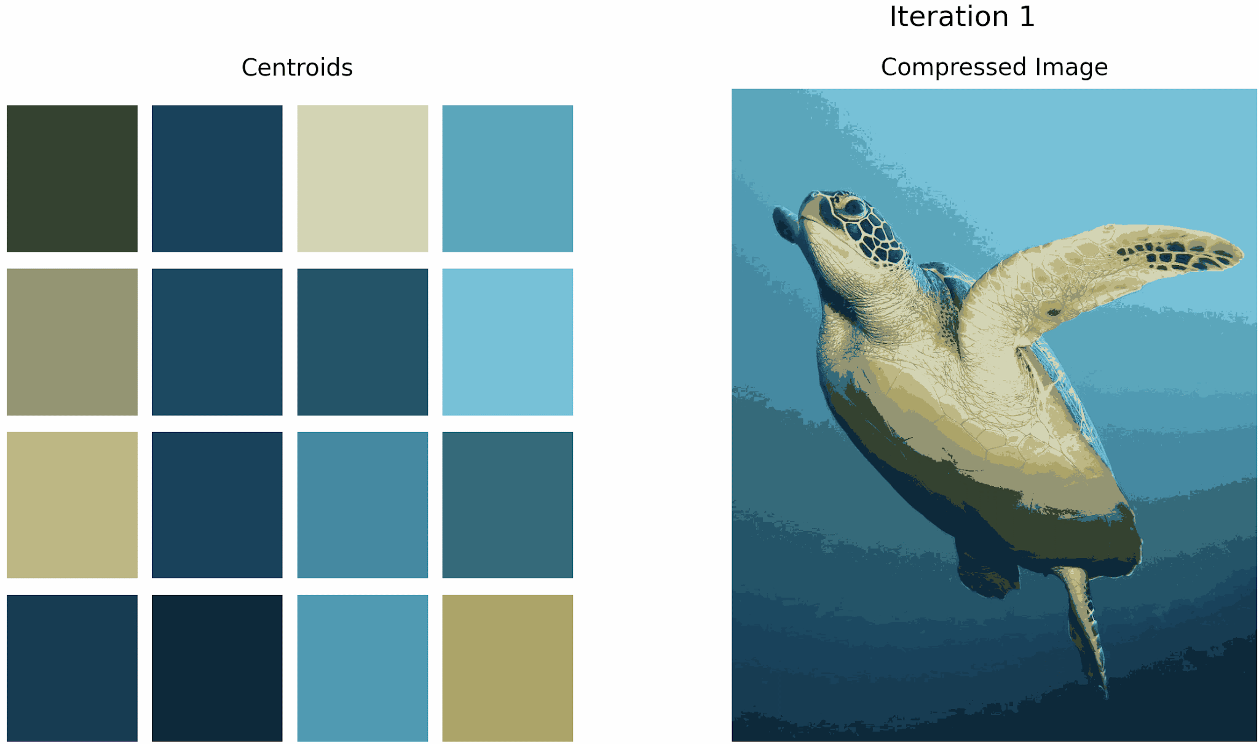
Image Compression using K-Means Clustering

Slide 9
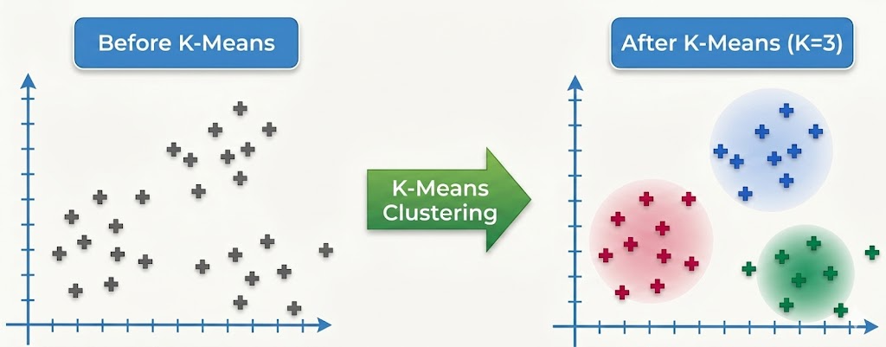

Slide 10
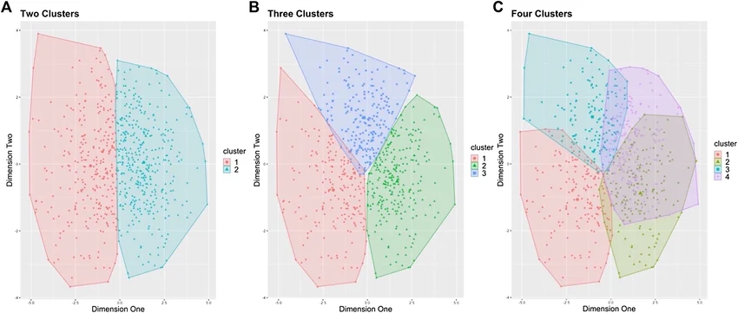

Slide 11
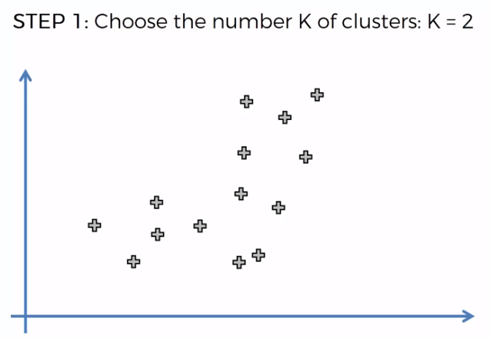

Slide 12
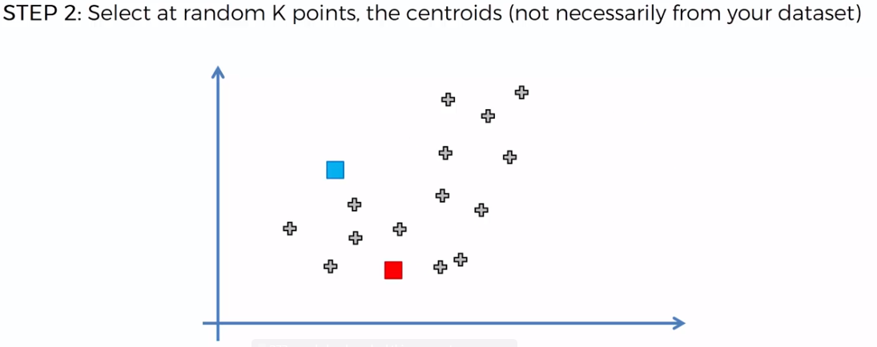

Slide 13
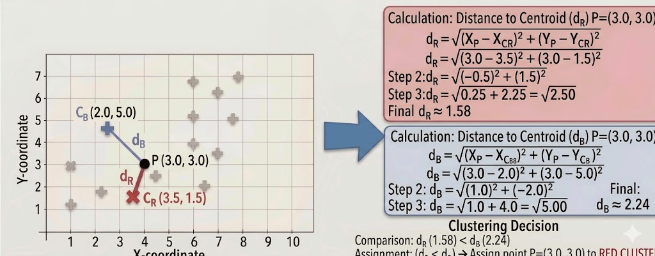

Slide 14
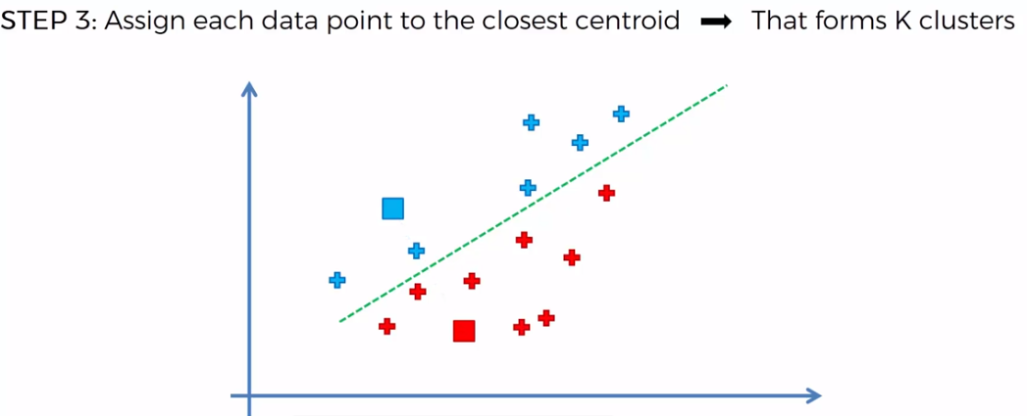

Slide 15
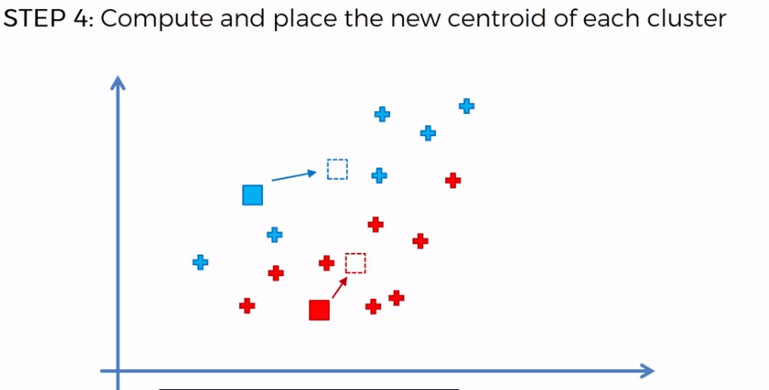

Slide 16
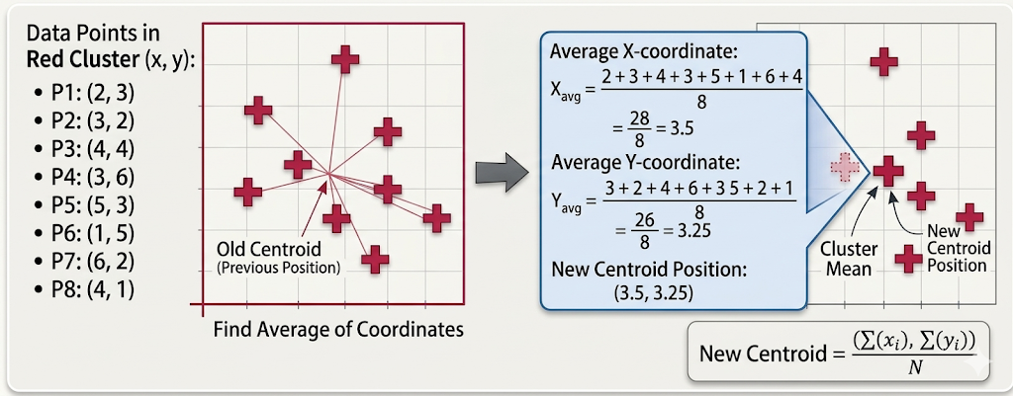

Slide 17
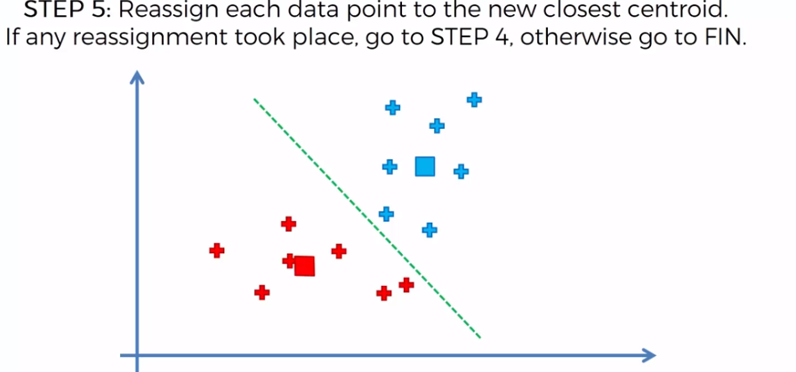

Slide 18
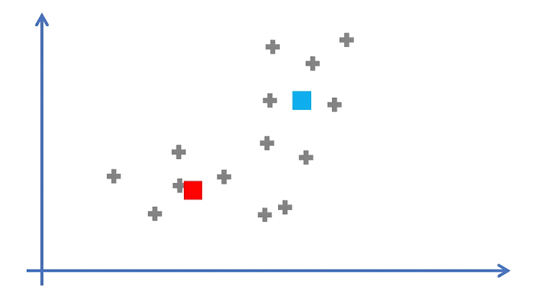

Slide 19
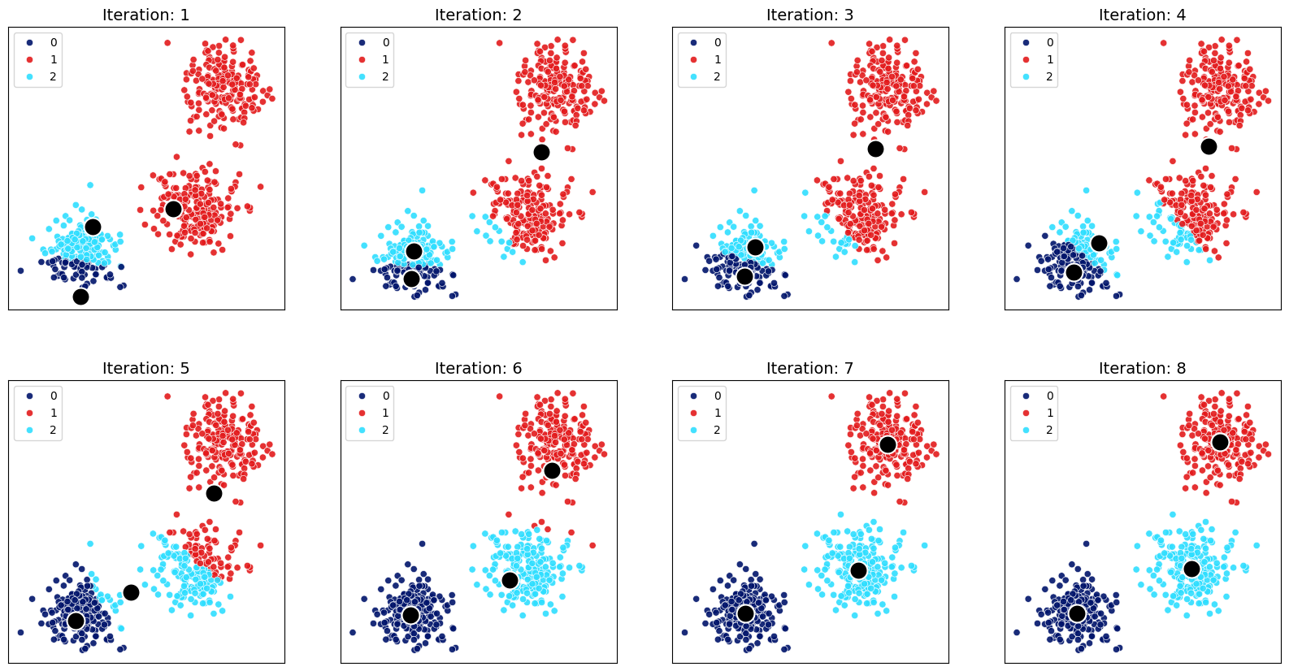

Slide 20
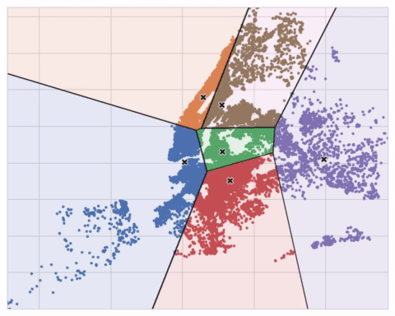

Slide 21
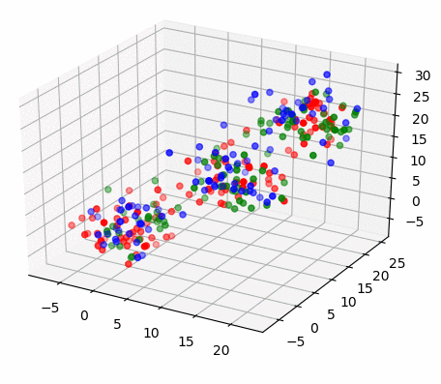
Kmeans in 3D

Slide 22
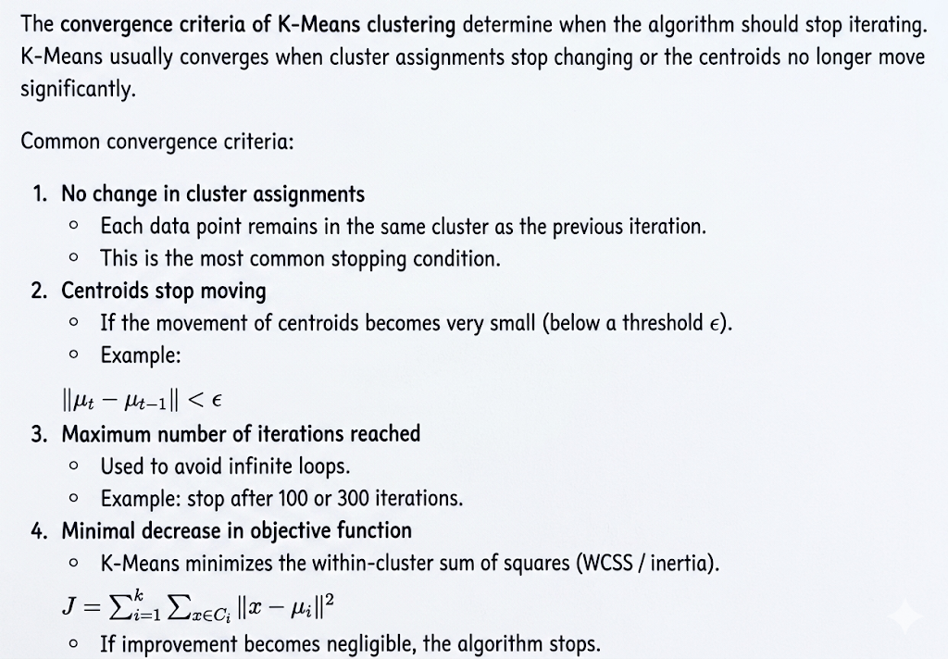

Slide 23
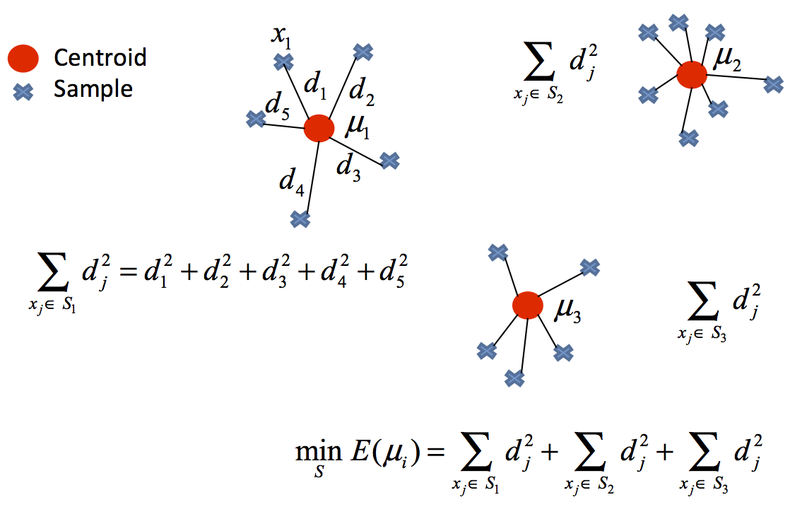
Objective: Minimize WCSS

Slide 24
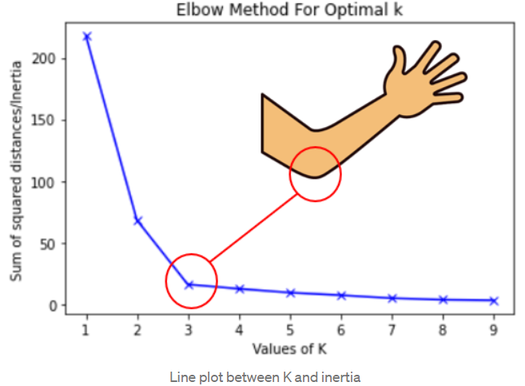
Finding Optimal K

Slide 25
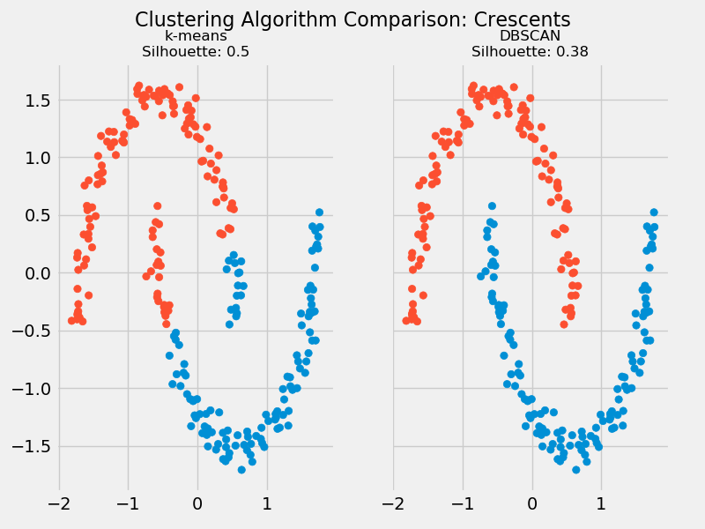

Slide 26
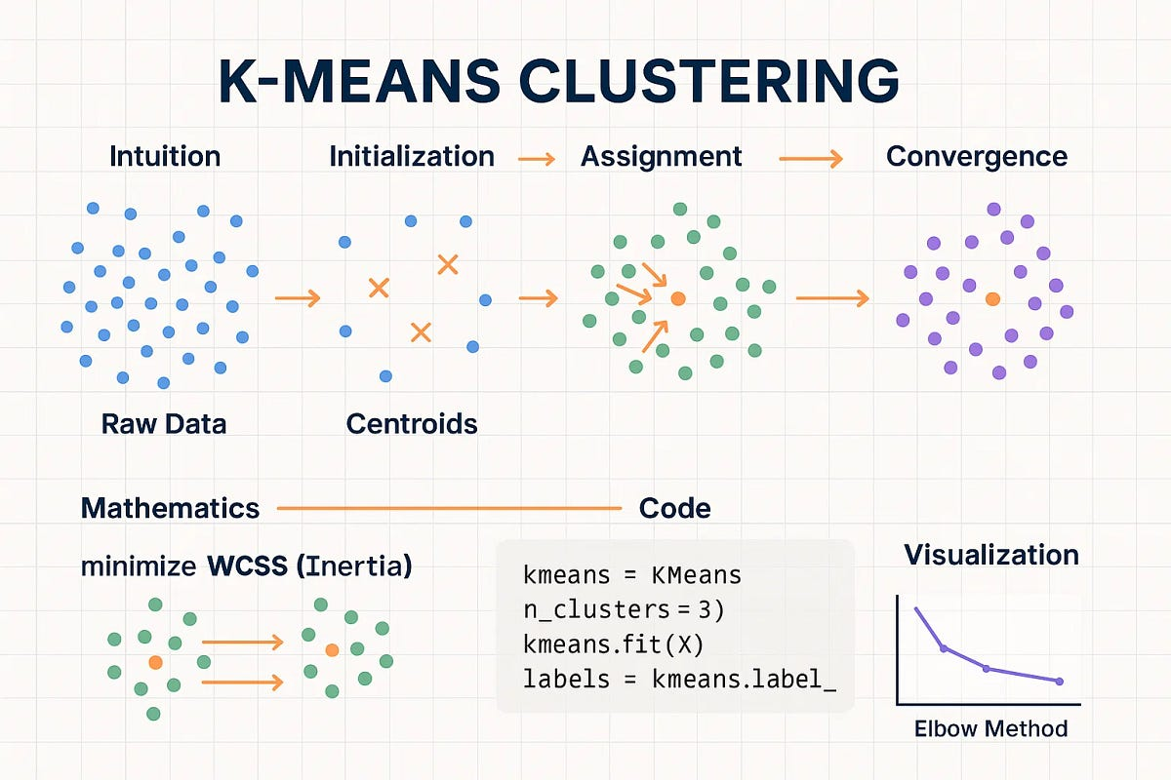

Slide 27
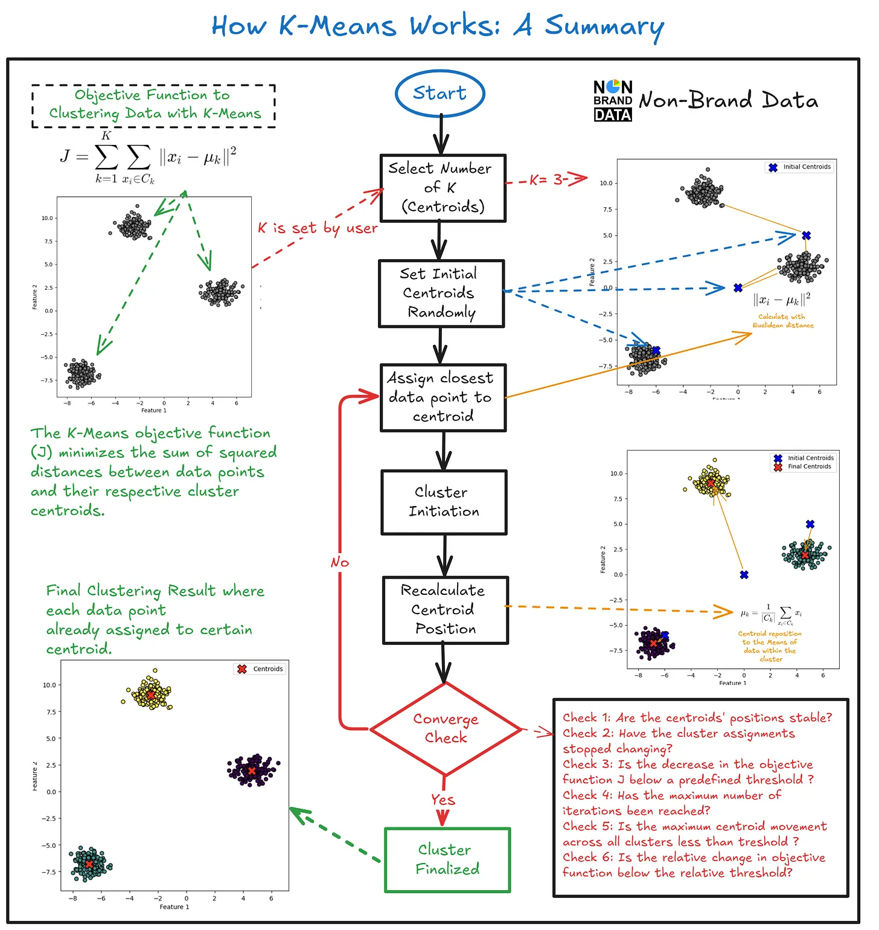

Slide 28
Principal Component Analysis

Slide 29
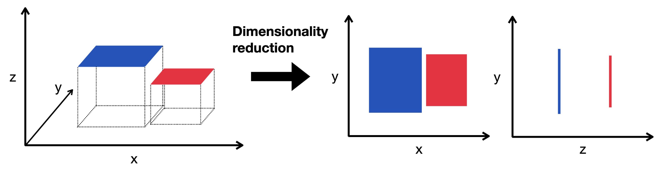
Dimensionality Reduction

Slide 30
Application
Feature Extraction (Dimensionality Reduction)
PCA creates a smaller set of new features (principal components) that preserve most of the information (variance) in the data.
Benefits:
Faster model training
Lower memory usage
Removes redundant/correlated information

Slide 31
Application
Visualization
PCA reduces high-dimensional data (e.g., hundreds or thousands of features) to 2 or 3 principal components so that it can be visualized.
Projects the data onto the directions with the highest variance.
Helps identify:
  Clusters
  Outliers
  Class separation
  Data distribution

Slide 32
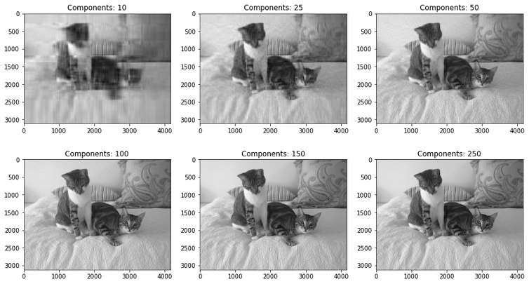
Application
Data Compression
PCA can compress data by storing only the most important principal components.
Instead of storing all original features, we store:
Principal component scores
PCA basis vectors (eigenvectors)
The original data can later be approximately
reconstructed.
Example: Image Compression

Slide 33
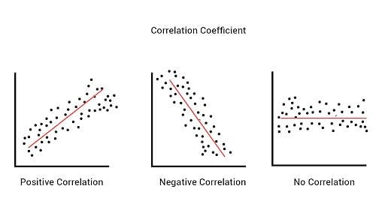
Correlation

Slide 34
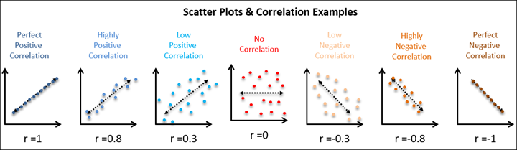
Correlation

Slide 35
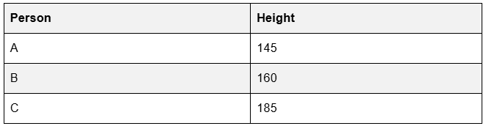
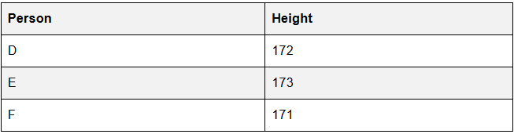
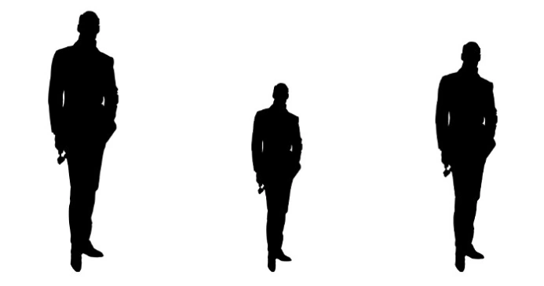
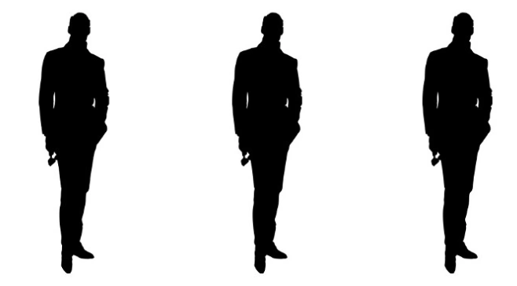
High Variance vs Low Variance

Slide 36
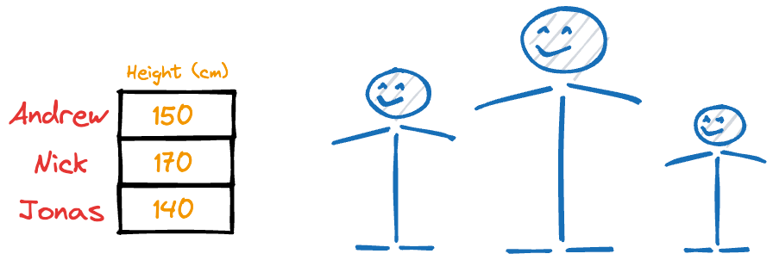
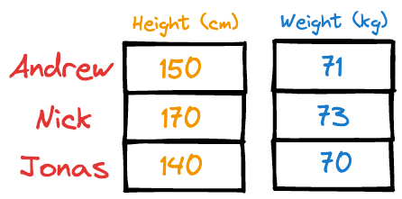
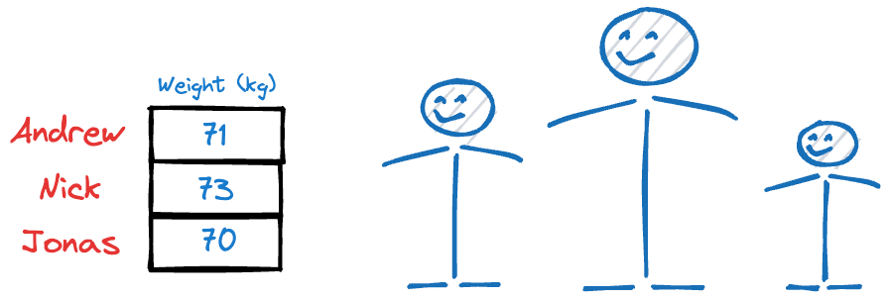
High vs Low Variance Feature

Slide 37
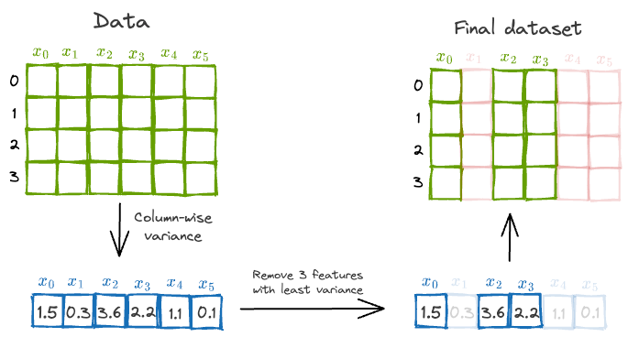

Slide 38
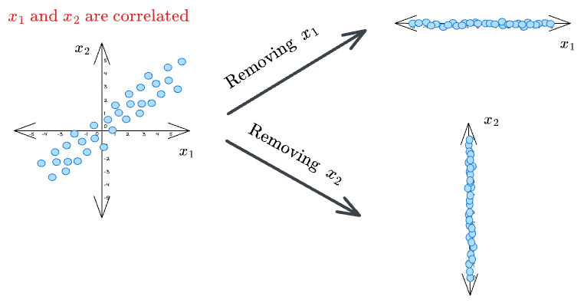

Slide 39
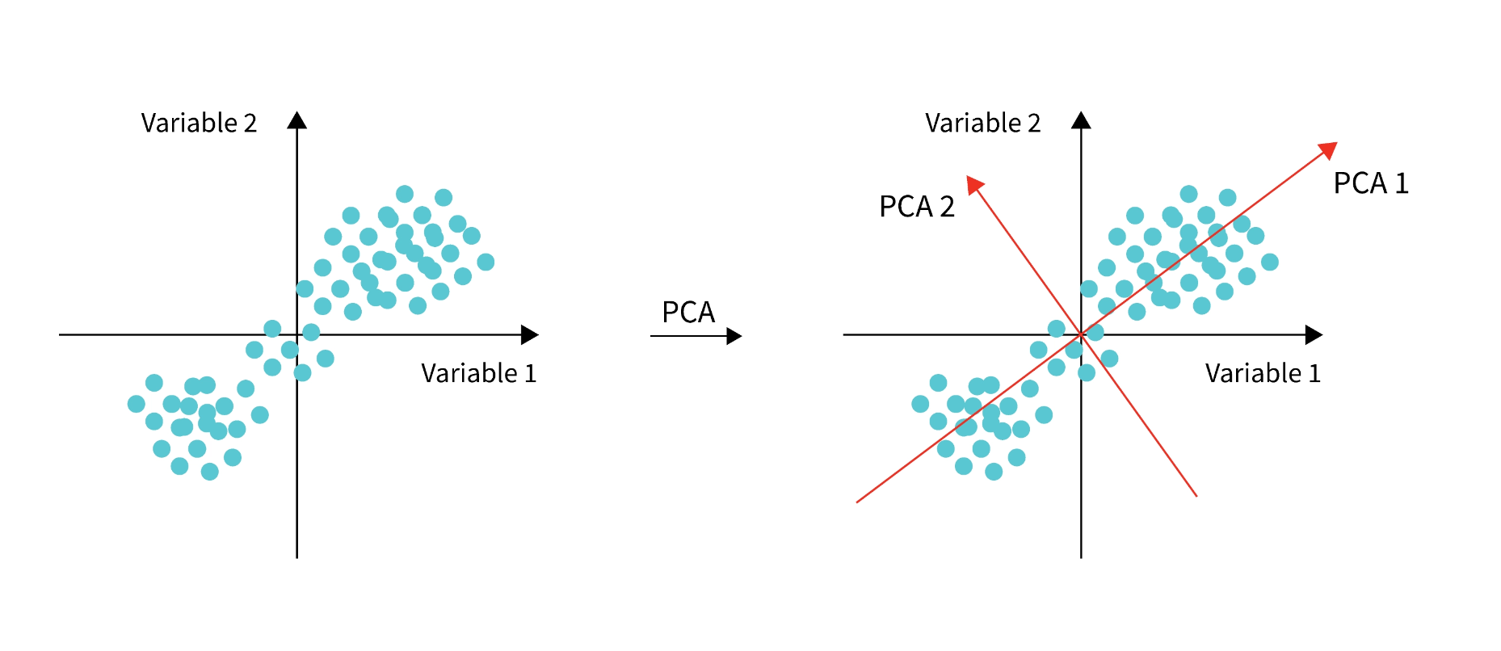

Slide 40
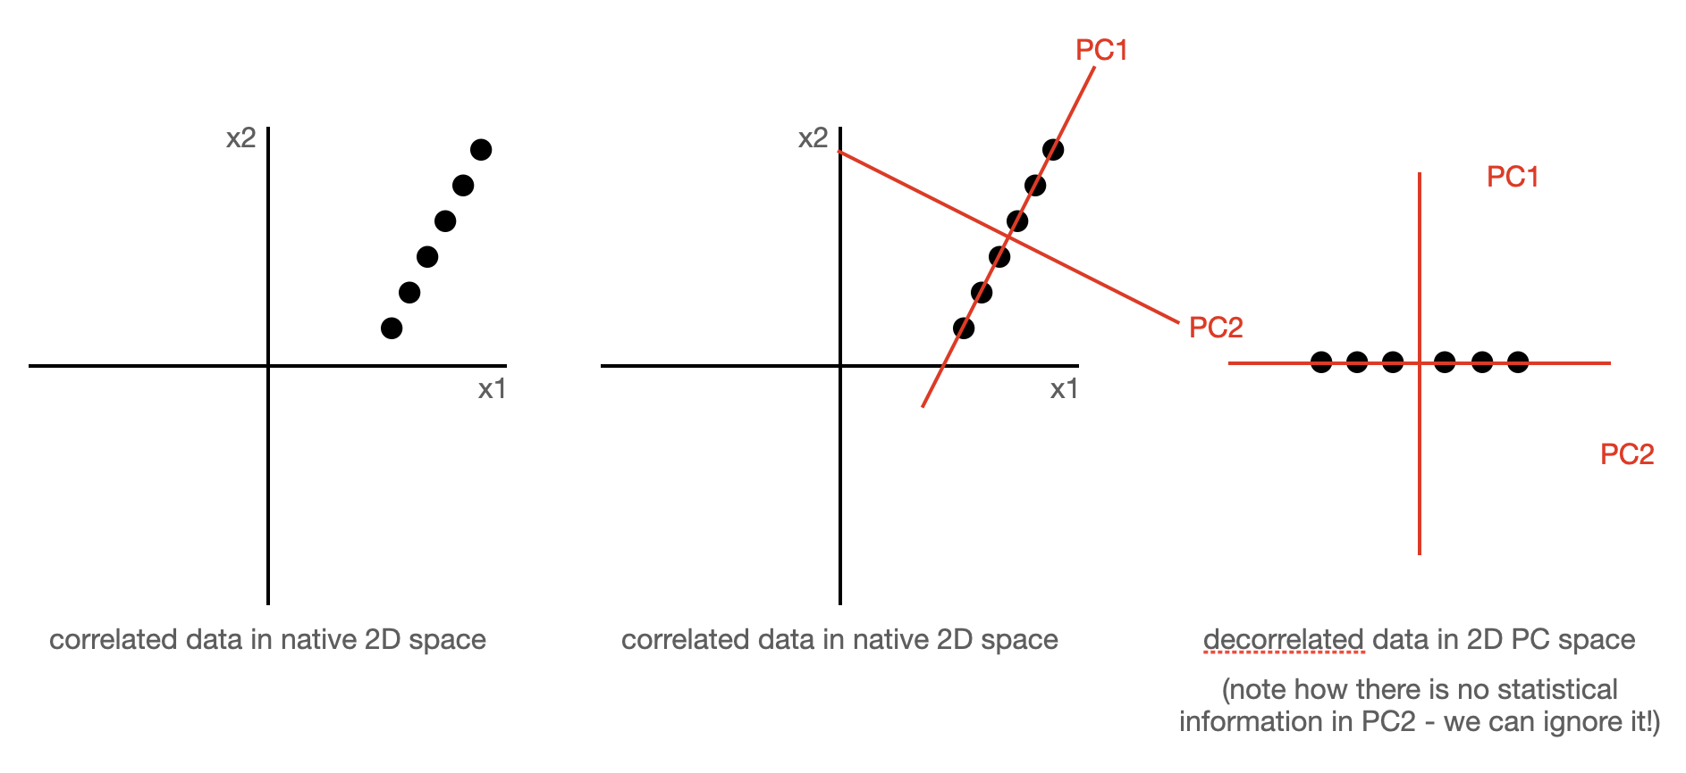

Slide 41
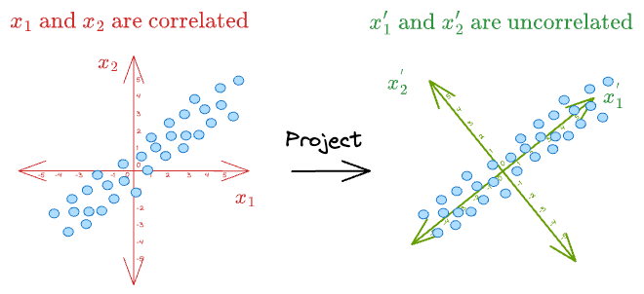

Slide 42
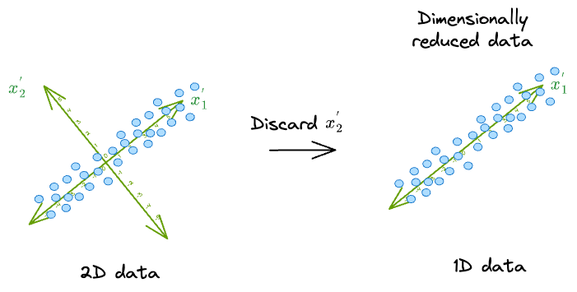
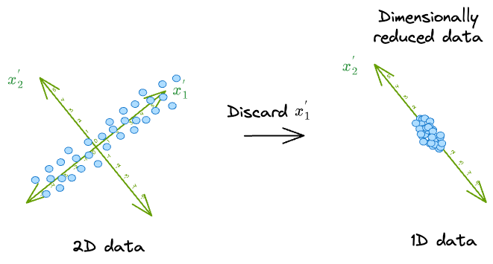

Slide 43
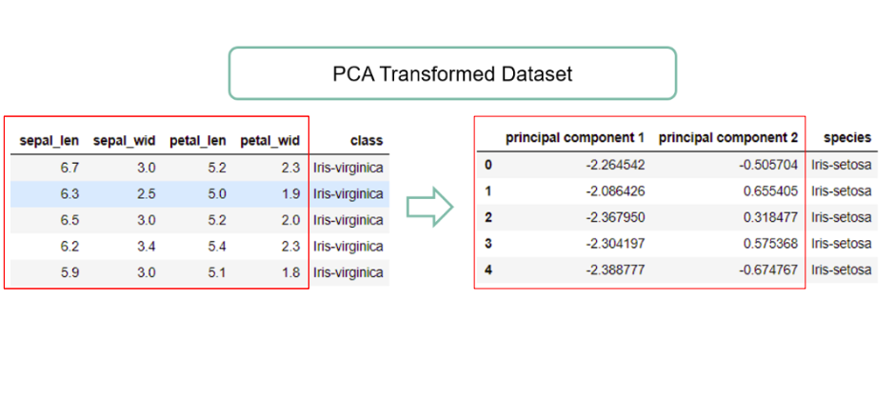

Slide 44
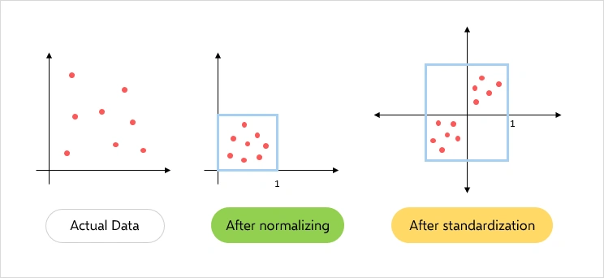
Step 1: Standardardization

Slide 45
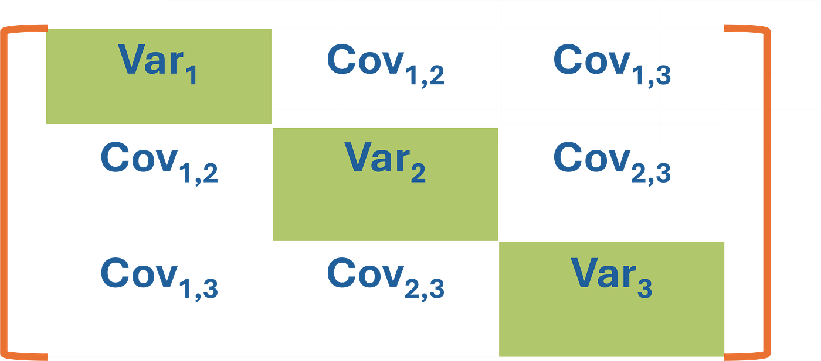
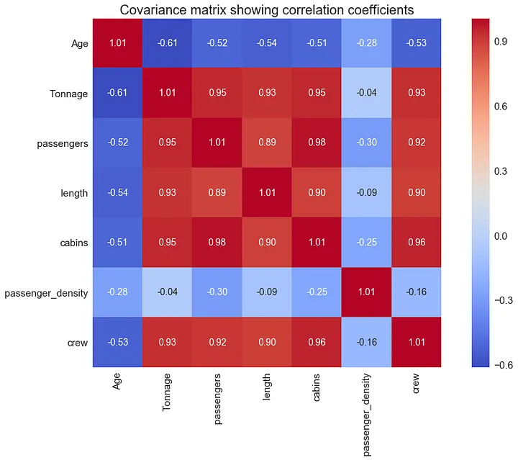

Step 2: Calculate Covariance Matrix

Slide 46



Step 3: Eigen Decomposition
instead of variable 1

Slide 47

Step 4: Decide number of components to keep

Slide 48

Eigenvector and Eigenvalue

Slide 49


Slide 50
Thank you!

